Slide 1
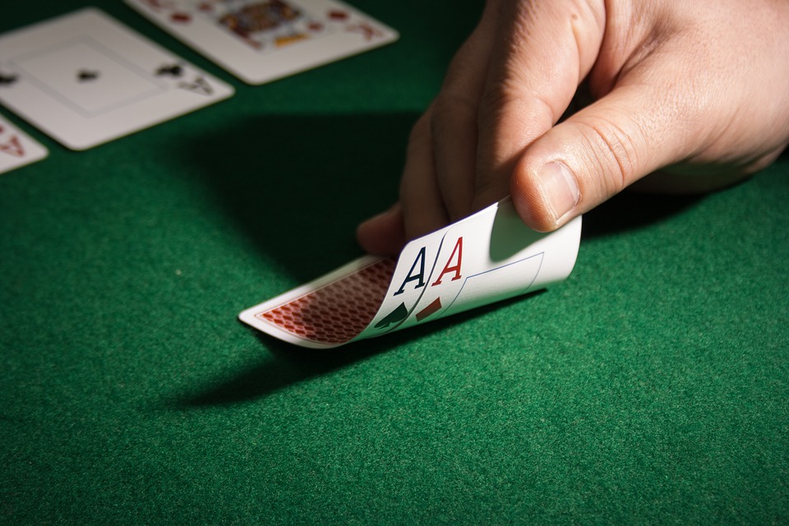
Simulating Blackjack
Using Reinforcement Learning
By Narasimha and Rash Pal

Slide 2
Introduction to Blackjack
Blackjack is a card game played against dealer
Both player and the dealer start with 2 cards
The player can only see one of the dealer’s cards
Card values
Ace value of 1 or 11 (Player’s choice)
King/Queen/Jack/10 value of 10
Cards from 2 to 9 same value as the card
The Goal
The goal of the game is to get the value of cards as close to 21 without going over

Slide 3
Introduction to Blackjack - Continued
RULES
If the player has value of less than 21
They choose to “hit” and receive a random card from the deck
They choose to “stand” and keep the cards they have
However…
If the player exceeds the value of 21, they automatically “bust” and lose the round
If the player has exactly 21, they automatically win the game
Otherwise, the player wins if they are closer to 21 than the dealer

Slide 4
Introduction to Blackjack - Continued
We will only give our players two options: hit or stand
Our players will start with $1000 cash value
We will assume that our player will bet $100 per round
Rewards and Penalty
Win: $100
Loss: -$100
Tie: No change
Notes:
A policy, in this context, is a playbook that tells the player (or our AI agent) exactly what decision to make in each possible situation. An AI agent is the abstract being that will be learning and updating its knowledge through our Reinforcement Learning algorithm.

Slide 5
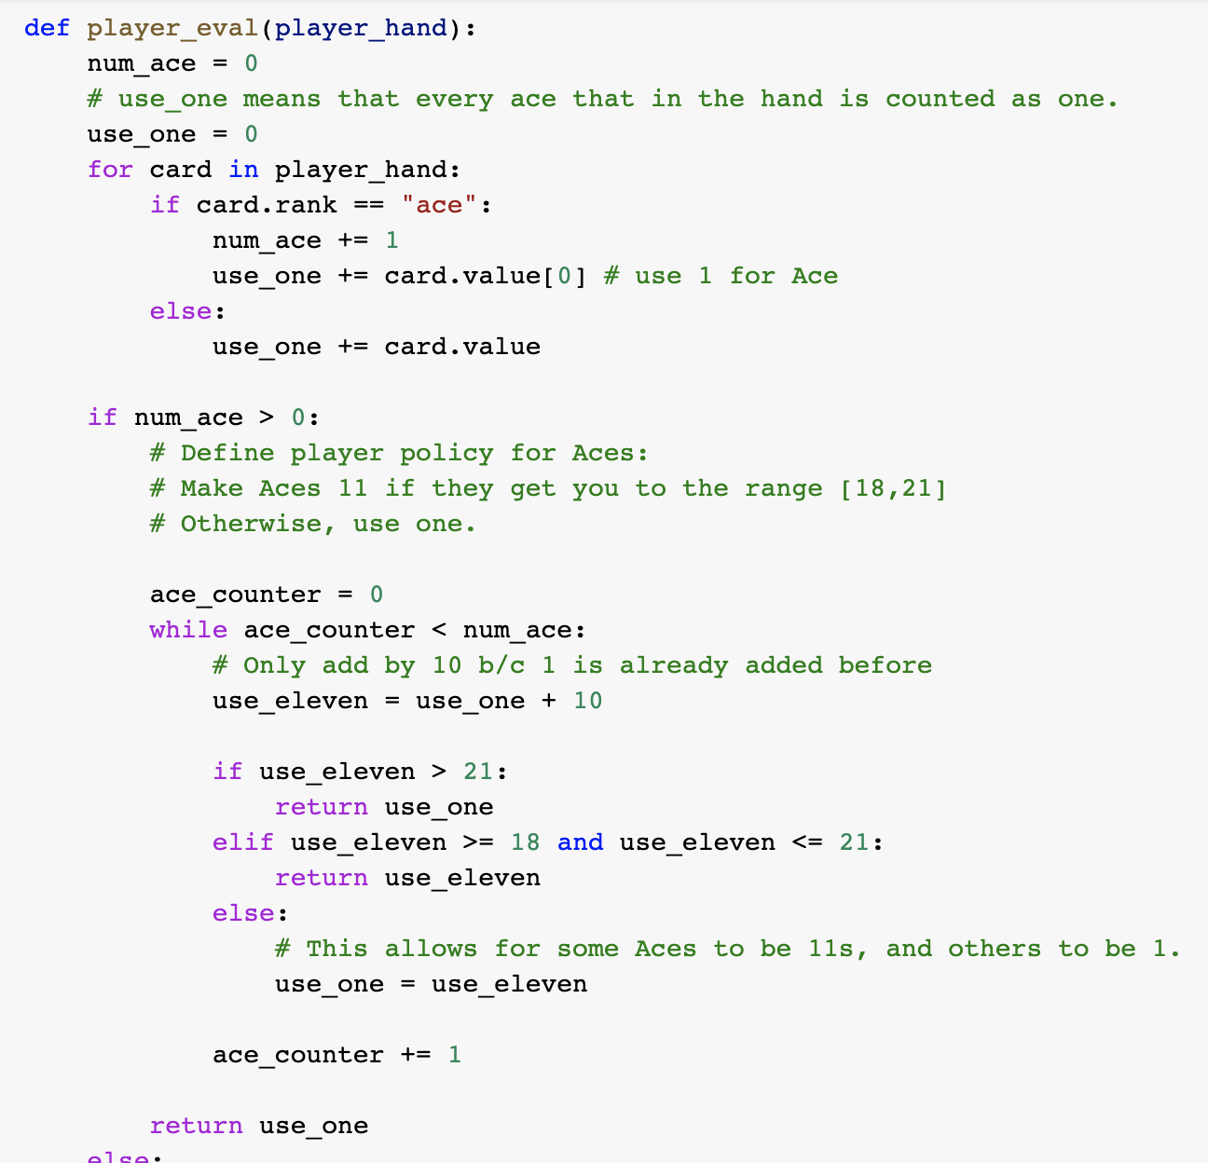
Building The Model
Defined a Card and a Deck using OOP principles (classes, functions, etc) and basic data structures (lists, dictionaries, etc)
Defined 2 functions that implement the logic behind a dealer’s turn and evaluating a dealer’s hand.
Defined a function to implement the logic behind evaluating the player’s hand.
Defined a master play_game() function that simulates games of Blackjack given parameters such as player policy, number of rounds, etc.
The focus of a part of our project will be playing with the player policy input to monte carlo simulation environment to see what insights we can gain.

Slide 6
Monte Carlo Simulations
Monte Carlo methods are best used for problems that would require humans large amounts of time to try and solve by hand.
For example, what is the expected return per round for a player if we “stand” when our hand is greater than or equal to 18, or “hit” otherwise?
Problems like this would be too tedious for humans to solve using a pen and a paper.
To tackle such questions, we have defined two types of player policies in our project.
Those two policies include: Discrete Policy and Stochastic Policy.
How did we implement these policies? What were the average returns for each round?
The next couple of slides will explain the logic implemented for these policies in detail.
Notes:
“In Blackjack, what is the expected return per round if we stand when our hand ≥ 18, and hit otherwise?”
A query such as this would be too overwhelming for a human to solve.
To answer this question, we will define our player policy as follows:

Slide 7
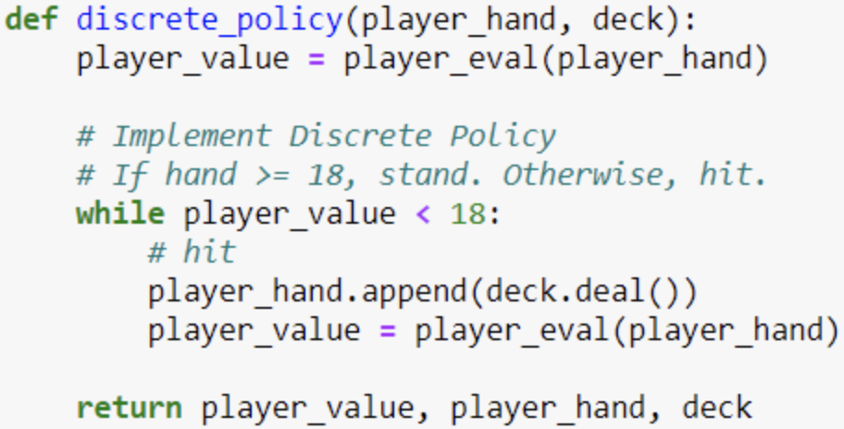
Discrete Policy
If hand is >= 18, stand
Else, hit
Notes:
“In Blackjack, what is the expected return per round if we stand when our hand ≥ 18, and hit otherwise?”
A query such as this would be too overwhelming for a human to solve.
To answer this question, we will define our player policy as follows:

Slide 8
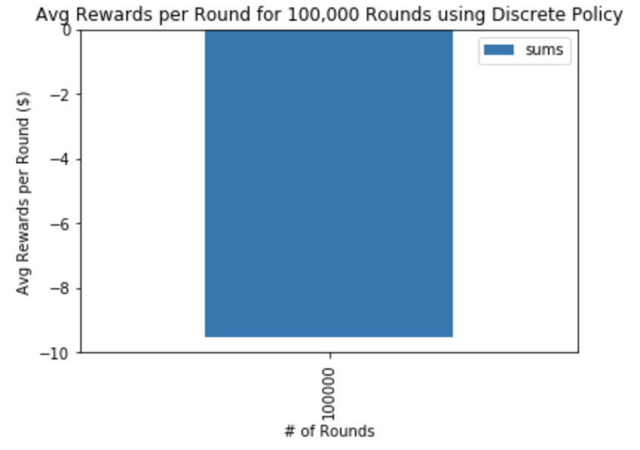
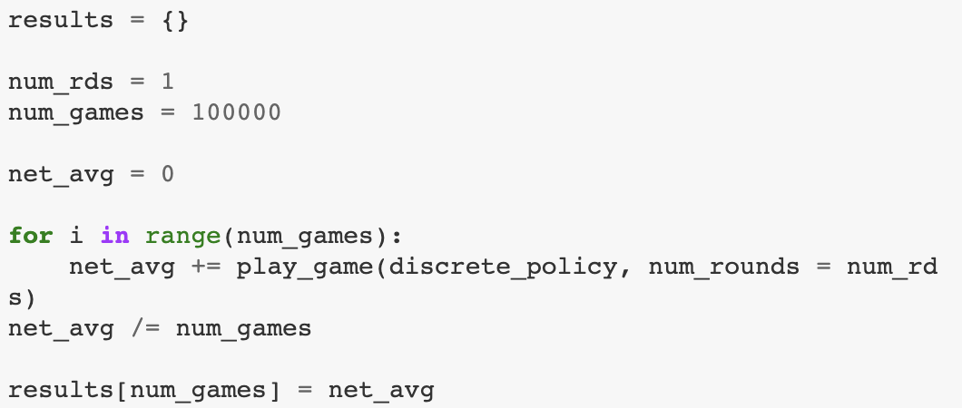
Discrete Policy - Continued
We conducted 100,000 simulations with one round per game to get our average win/loss
Notes:
a player would lose $10 every round if they decided to use the Discrete Policy.

Slide 9
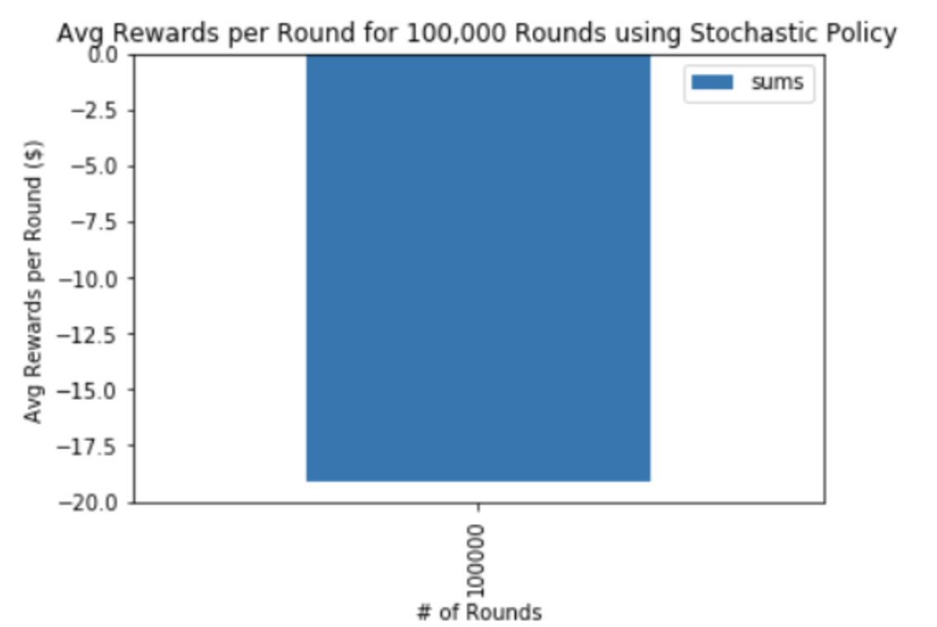
The Stochastic Policy
Allow room for randomness when picking an action
If hand >= 18: 80% stand and 20% hit
Else: 80% hit and 20% stand

Slide 10

Discrete vs Stochastic
Let’s discuss why our Discrete policy performs better than the Stochastic
Human intuition vs AI agent

Slide 11
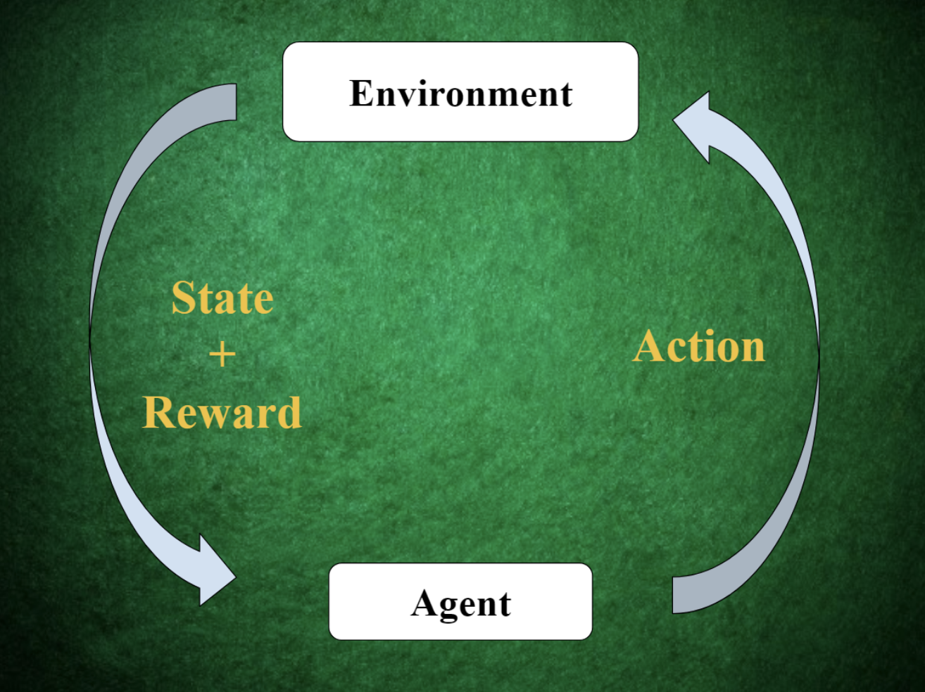
The Reinforcement Learning Cycle
Agent: AI abstraction that carries out the learning process
Environment: All possible situations the agent can interact with
State: The “situations” that help make up the environment
Actions: The options available to the agent in interacting with some given state.
Reward: The feedback that the agent receives for its action in some given state.

Slide 12
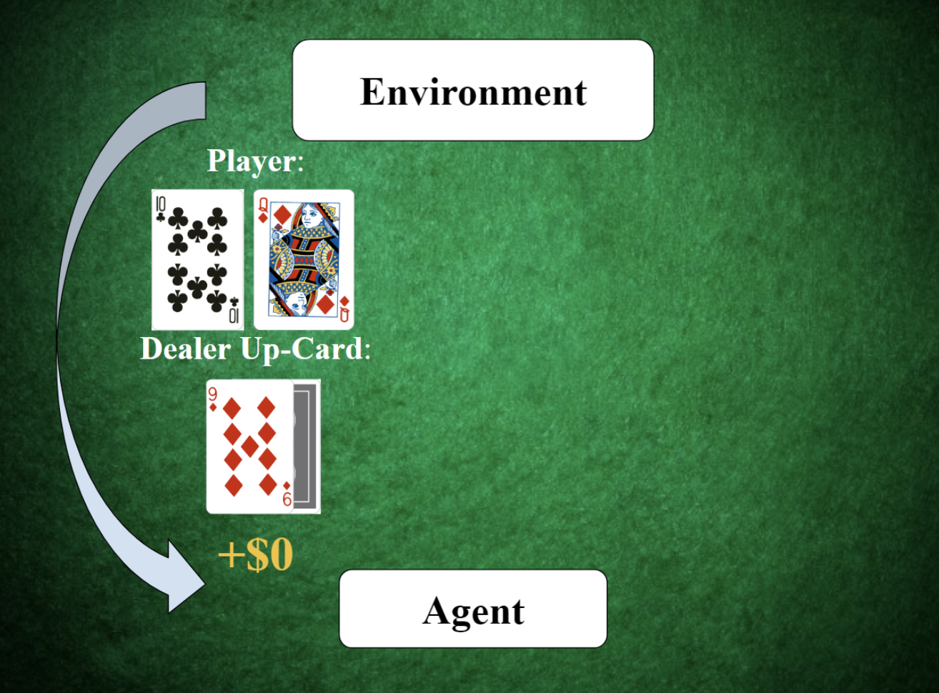
How do these components work in Blackjack
Two actions: Hit or Stand
Policy: Discrete or Stochastic
States: Player’s hand value and the Dealer’s up-card value

Slide 13
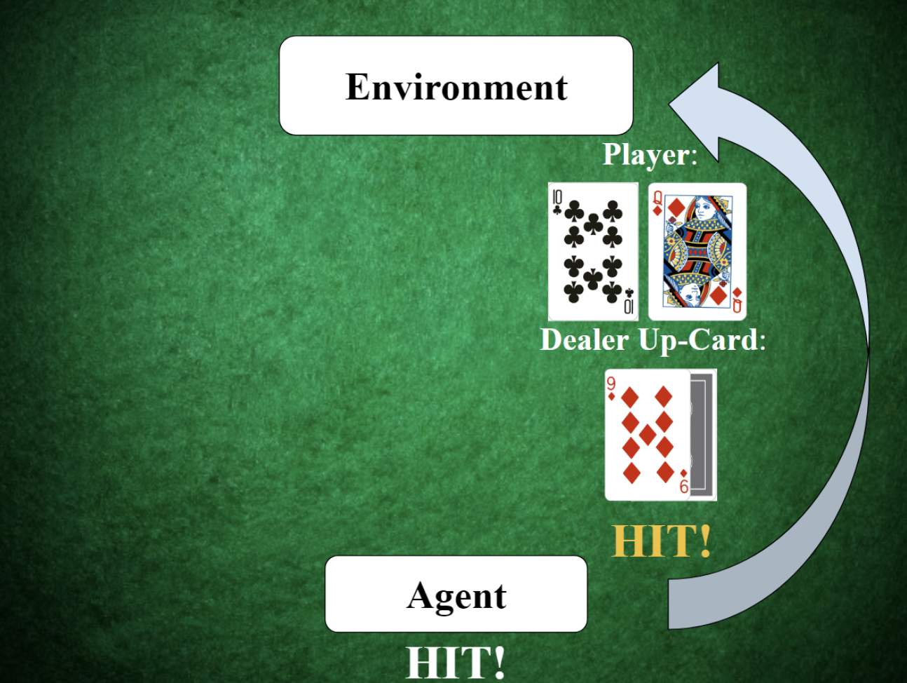
How do these components work in Blackjack
Two actions: Hit or Stand
Policy: Discrete or Stochastic
State vs Action

Slide 14
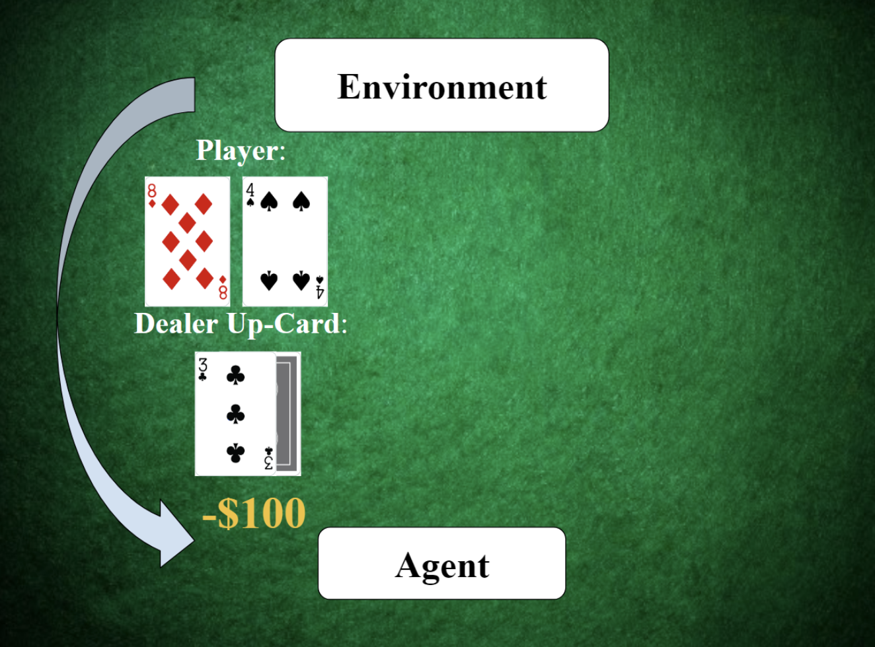
How do these components work in Blackjack
Two actions: Hit or Stand
Policy: Discrete or Stochastic
State vs Action
New State and New Action

Slide 15
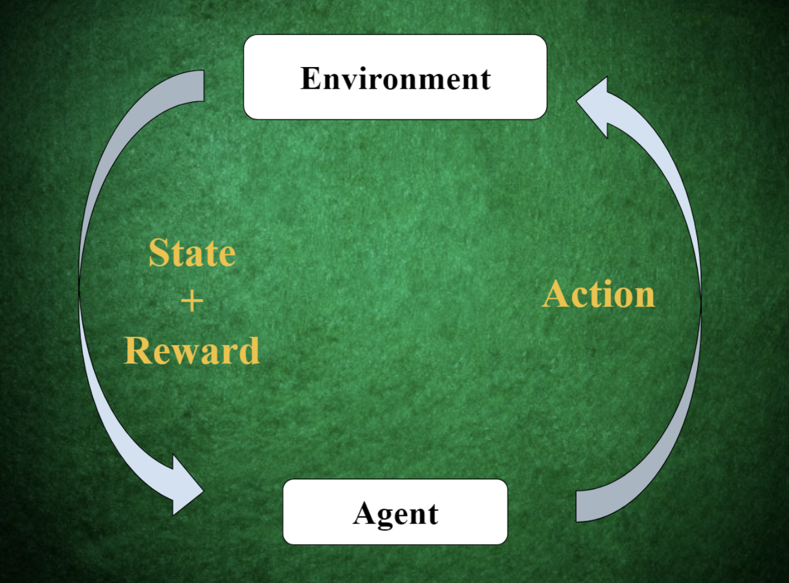
How do we learn?
State -> Action -> Reward

Slide 16
Open AI Gym Framework for Blackjack
We will now build our new Blackjack environment within the framework of OpenAI Gym.
This framework provides a standardized method of defining our environment so that we can easily experiment with other self-written and open-source Reinforcement Learning algorithms.
This framework also provides useful API to define our states, actions, and rewards more comprehensively.
To build our environment, we will be defining the functions in the Open AI Gym environment template.
These functions are the necessary pieces in modeling the cycle process of Reinforcement Learning.
Notes:
“In Blackjack, what is the expected return per round if we stand when our hand ≥ 18, and hit otherwise?”
A query such as this would be too overwhelming for a human to solve.
To answer this question, we will define our player policy as follows:

Slide 17
Open AI Gym Framework for Blackjack
__init__(): Initialize the Blackjack deck, the reward space (+$100, +$0, or -$100), the action space (hit or stand), and the observation space (or the set of all possible states. Each state is comprised of player hand value and dealer up-card).
reset(): Reset the episode and give the initial state to the agent.
step(action): The agent uses our algorithm to choose an action, and uses this function to send that action to the environment. This function simulates the processes of the environment (dealing new cards on hit, calculating rewards, etc). Then, it returns a new state, rewards, and whether the episode is done.
render(): A function to display relevant info such as State/Action/Reward tuples during different phases of an episode. Does not contribute to looping around the cycle.
Notes:
“In Blackjack, what is the expected return per round if we stand when our hand ≥ 18, and hit otherwise?”
A query such as this would be too overwhelming for a human to solve.
To answer this question, we will define our player policy as follows:

Slide 18
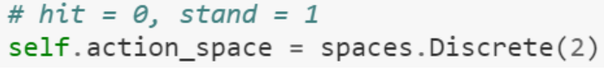
Open AI Gym Framework for Blackjack
In the __init__(): we utilize OpenAI Gym’s spaces functions to define our action space: hit or stand. We use a discrete set of two binary choices: 0 for hit, and 1 for stand.
Next, we define the observation space. An observation space is a set of all of the possible states that an agent can observe and respond to. A state in our version of Blackjack is the player’s hand value and the dealer’s up-card.
For hand values 21 (Blackjack!) and beyond (bust), the agent does not have to make any decisions.
The player’s hand value range is 3 through 20, and that is a range of 18 discrete values. The dealer up-card range is 2 through Ace, and that is a range of 10 discrete values.
Notes:
“In Blackjack, what is the expected return per round if we stand when our hand ≥ 18, and hit otherwise?”
A query such as this would be too overwhelming for a human to solve.
To answer this question, we will define our player policy as follows:

Slide 19

Open AI Gym Framework for Blackjack
Then, the function sees if the episode of Blackjack is now done after taking the action.
If the episode is now done, then the function re-uses the logic from play_game() to determine the winner and rewards.
Finally, the function returns the new state, the rewards, and whether the episode is done. { } is a return value to provide a description of what happened in the function, but we leave it empty for now.
The render() function uses simple print() functions to display the player’s hand value, the cards in the player’s hand, the dealer’s up-card, and the value of env.done.
Notes:
“In Blackjack, what is the expected return per round if we stand when our hand ≥ 18, and hit otherwise?”
A query such as this would be too overwhelming for a human to solve.
To answer this question, we will define our player policy as follows:

Slide 20
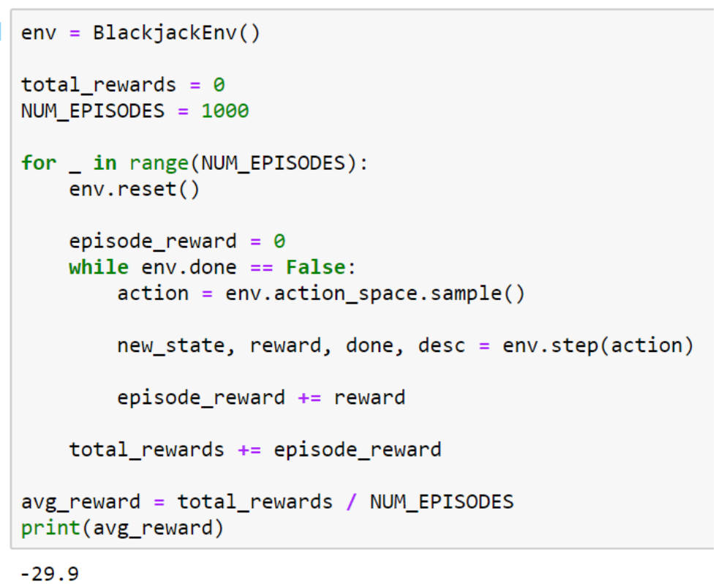
Open AI Gym Framework for Blackjack

Slide 21
The Building Blocks of RL Algorithms
There are various key building blocks that are used in the Reinforcement Learning algorithm. Our project utilizes these parameters, to maximize Blackjack returns.
In short, the only thing our Reinforcement Learning algorithm will do is define what the agent should do with state → action → reward tuples (explained in previous slides) after each episode.
The key data structures that will be utilized in our algorithm includes:
Q Table: A table to keep track of the value (or Q-value) of choosing an action given some state. A Q-table is built by taking a cross-product of the observation_space and action_space defined in our Blackjack environment. The initial Q-value for all state/action pairs is 0.
Prob Table: a cross-product of the observation_space and action_space. This table contains the probability the agent will choose an action given some state. This reinforces the stochastic approach to policies. The initial probabilities for actions for each state will be 50% hit / 50% stand.
Notes:
“In Blackjack, what is the expected return per round if we stand when our hand ≥ 18, and hit otherwise?”
A query such as this would be too overwhelming for a human to solve.
To answer this question, we will define our player policy as follows:

Slide 22
The Building Blocks of RL Algorithms (Continued..)
The important variables impacting agent’s learning includes:
Alpha (α): This can be thought of as the learning rate. After our agent gets rewards from the environment for an action in some state, it will update the Q-value of the corresponding state-action pair in our Q-table. The value of alpha ranges from 0 to 1.
Epsilon (ε): This can be thought of as an analogous “learning rate” for probabilities in the Prob table. When our agent gets a reward for some state + action, it will also tweak the probability of taking that same action in the future. The value ranges from 0 to 1.
Epsilon Decay (ε-decay) : This is the rate at which ε decays after each episode. At the beginning of the agent’s learning process, we would like ε to start high and make small changes to the Prob table because we want our agent to explore new actions. This helps ensure the final policy isn’t skewed heavily by randomness early in the learning process.
Notes:
“In Blackjack, what is the expected return per round if we stand when our hand ≥ 18, and hit otherwise?”
A query such as this would be too overwhelming for a human to solve.
To answer this question, we will define our player policy as follows:

Slide 23
The Building Blocks of RL Algorithms (Continued..)
Epsilon Minimum (ε-min) : The explore vs exploit dynamic is very delicate; the transition from explore to exploit can be very sudden if you are not careful. The ε-min variable sets a limit for how much one episode can alter the probability of an action for some state in the Prob table.
Gamma (γ) : How much is the initial “hit” action responsible for the final reward? γ helps explain this. We use γ as a discount rate on the final rewards of an episode to approximate the reward of the initial “hit” action. γ must be > 0 and ≤ 1.
Notes:
“In Blackjack, what is the expected return per round if we stand when our hand ≥ 18, and hit otherwise?”
A query such as this would be too overwhelming for a human to solve.
To answer this question, we will define our player policy as follows:

Slide 24
First-visit Monte Carlo Implementation
Pseudo code for First-Visit MC:
1. Initialize the Blackjack environment. Which we already did using Open AI gym.
2. Define the Q-table, Prob-table, alpha (α), epsilon (ε), ε-decay, ε-min, and gamma (γ).
3. Define how many episodes you would like your agent to learn from.
4. Play an episode. Record all of the (state → action → reward) tuples in the episode.
5. After the episode, apply ε-decay/ε-min to ε.
6. Then, update the Q-table and the Prob-table using (state → action → reward) from Step 4.
7. Repeat Steps 4–6 for the number of episodes defined in Step 3.
8. After all episodes, the resulting Q-table and Prob-table represent the optimized policy.
Notes:
“In Blackjack, what is the expected return per round if we stand when our hand ≥ 18, and hit otherwise?”
A query such as this would be too overwhelming for a human to solve.
To answer this question, we will define our player policy as follows:

Slide 25
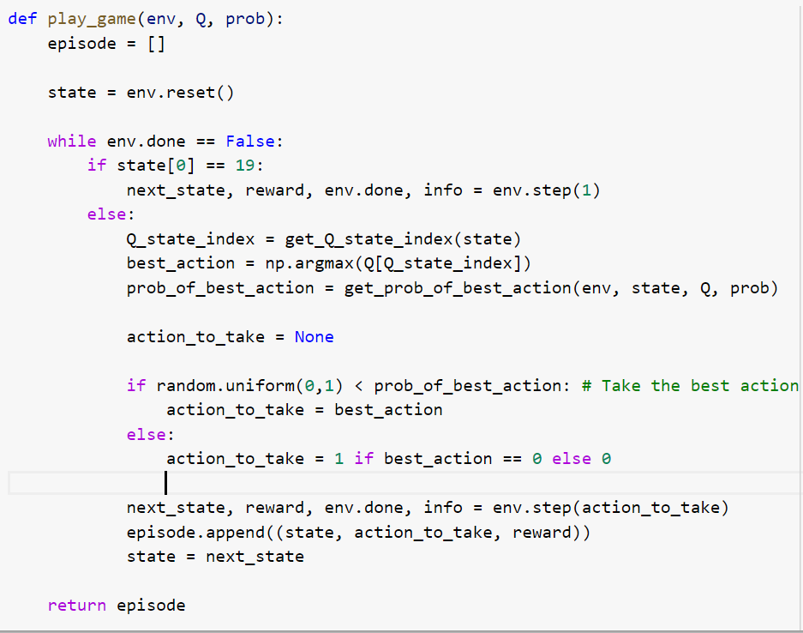
First-visit Monte Carlo Implementation
Step 4 (Playing an episode) : We will leverage our Blackjack environment’s functions defined in previous slides to simulate an episode. We will also make use of the Q-table and Prob-table.

Slide 26
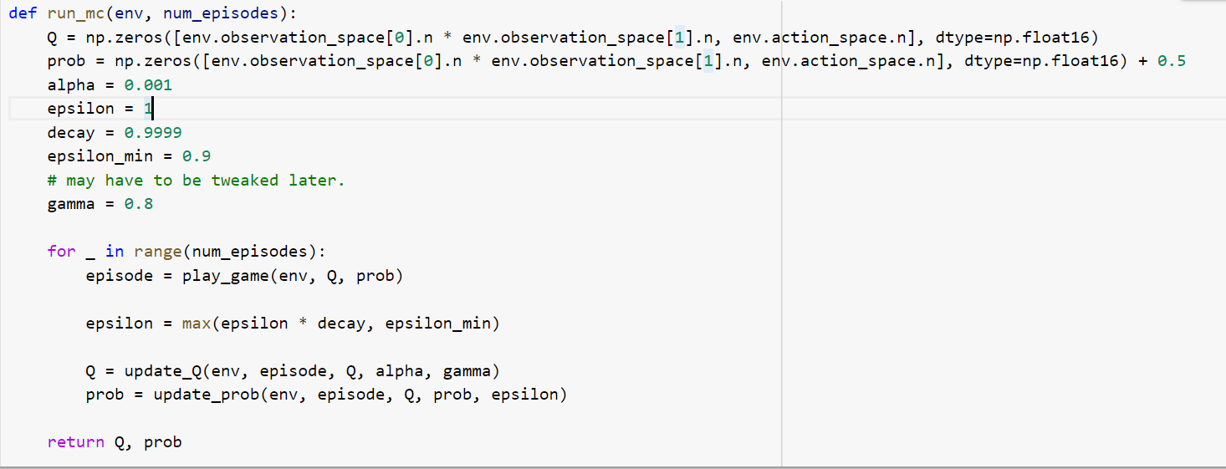
Finishing the First-Visit Monte Carlo Algorithm

Slide 27
Finishing the First-Visit Monte Carlo Algorithm
In this slide, let’s focus on our update_Q(). The reason this is called the “First-Visit” MC algorithm is because we have a first-visit approach to evaluating rewards.
“First-Visit” means that we want to start tracking the rewards of a state-action pair from its first occurrence in the episode, and then use the cumulative rewards of the episode to update our Q-values for that state-action pair in our Q-table.
The other option is an “Every Visit” approach. In this approach, we use the immediate rewards of a state-action pair every time it occurs in an episode to update Q-values.
It doesn’t make sense to use the every-visit approach for our problem given the format of Blackjack and how we have set up our environment.
The rewards for state-action pairs in our episodes are all 0 except for the final state-action pair. This is because Blackjack players (and our agent) may have to make more than one decision (meaning more than one state-action pair) before the results of the Blackjack round (or episode) is known.
Therefore, our agent will not improve much if we force it to update the Q-values in the Q-table using immediate rewards of $0 after each state-action pair. Instead, we will use the rewards for the final state-action pair and discount them to approximate the value of a prior state-action pair within the same episode.

Slide 28

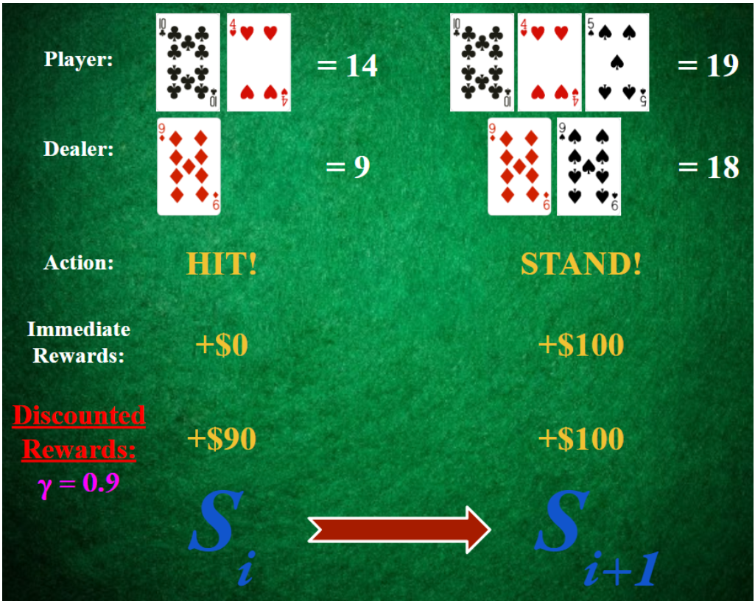
Finishing the First-Visit Monte Carlo Algorithm
Formula to find discounted rewards for state-action pairs in each episode & visual representation:

Slide 29

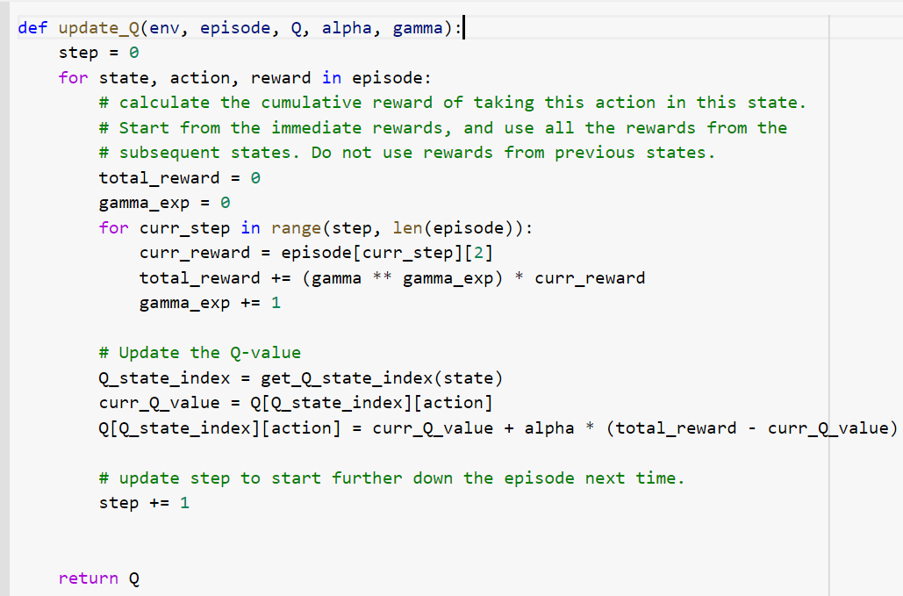
Finishing the First-Visit Monte Carlo Algorithm
Here is the formula for the change in Q-value for each state-action pair encountered in our episode:

Slide 30
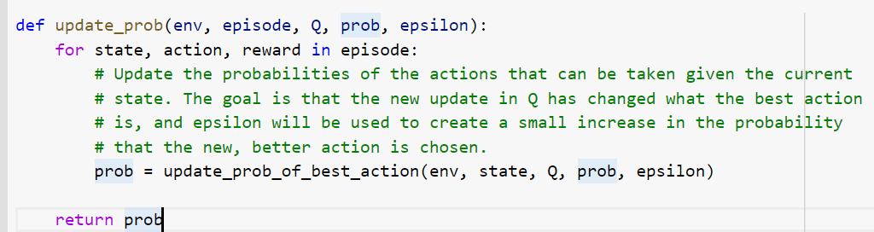
Finishing the First-Visit Monte Carlo Algorithm
This is the final step of our algorithm, where we update probabilities using our update_prob() function.
update_prob() tweaks the probability distribution of taking a hit or stand action for each state encountered in our episode. update_prob() is called after update_Q() finishes because Q-values influence how the probabilities get updated, and we want the most updated Q-values.
After this step, get and update probabilities of best action and finally display our implemented game strategy graphically and compute the average reward for 100000 episodes. This way we can verify the outcome of First-Visit MC algorithm with our previously used algorithm.

Slide 31
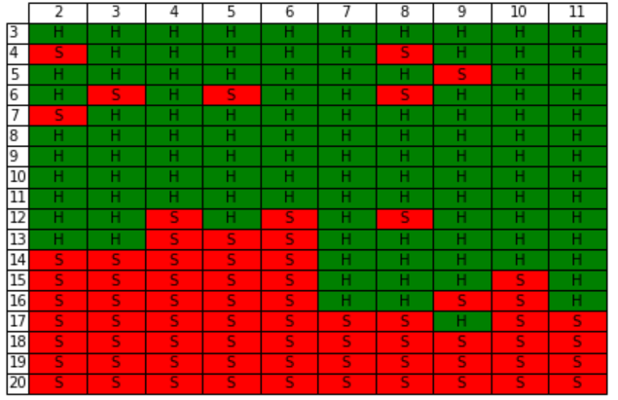
Finishing the First-Visit Monte Carlo Algorithm
Our best strategy chart computed using the First-Visit MC algorithm

Slide 32
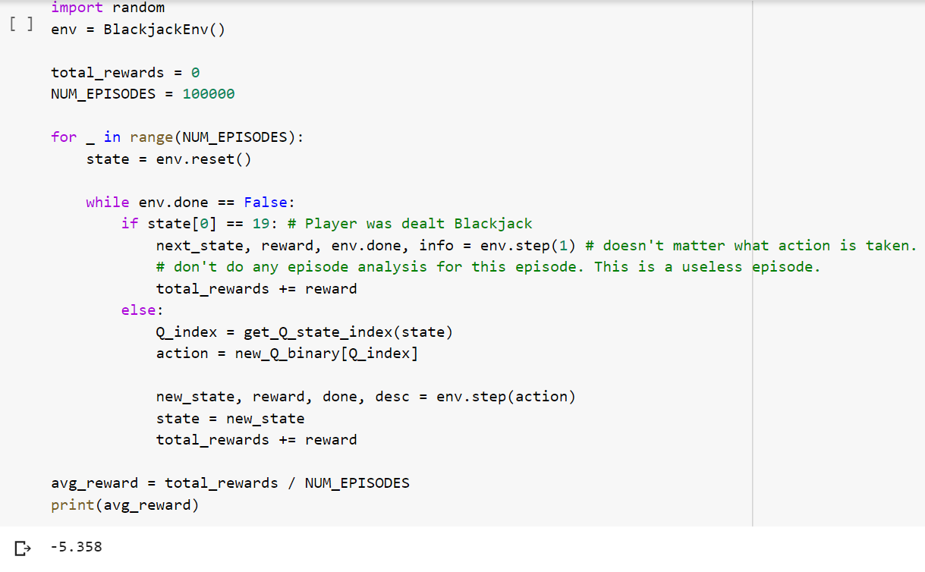
Finishing the First-Visit Monte Carlo Algorithm
Calling the BlackJack() environment to compute the average reward for 100000 episodes:

Slide 33
CONCLUSION & FUTURE WORK
Thank you one and all for patiently listening to our presentation!
I would also like to thank Rash for his support throughout the project.
Last but not the least, thank you Francesco, for providing this opportunity to showcase our findings.
In future, we would like to extend this project by trying out other advanced RL algorithms and compare the average reward to decide the best possible algorithm to crack the Blackjack game.
Also, we would like to experiment with Edward Thorpe's Basic Strategy to simulate a couple of episodes which is well known to give a decent earnings per episode.

Slide 34
REFERENCES
https://bicyclecards.com/how-to-play/blackjack/

